Slide 1
Project Review 1
Hospital Management System
Department of Artificial Intelligence &Machine Learning
TEAM MEMBERS
P.UMASRINU-25B11AI891
P.Udayakiran -25B11AI880
P.Madhavan -25B11AI873
P.Sudeep- 25B11AI941
Guided by : Mrs.GL Narasamba
CO-Guided by: Dr.P.V.V.S.D. Nagendrudu

Slide 2
Contents
Abstract
Introduction
Problem Definition
Objectives
Database Schema – Tables & Attributes
ER-Diagram-Entities & Relationships
Modules & Functionalities
SQL Operation & Queries
Conclusion

Slide 3
Abstract
The Hospital Management System is a software application used to manage hospital activities such as patient registration, doctor details, appointments, medical records, medicines, and billing. It reduces paperwork, saves time, minimizes errors, and provides easy access to patient information. The main aim is to make hospital management simple, fast, and efficient

Slide 4
Introduction
The Hospital Management System is a computerized system designed to manage and organize hospital activities efficiently. It helps maintain patient records, doctor details, appointments, medicines, and billing. The system reduces manual paperwork, saves time, minimizes errors, and provides quick access to information. Its main purpose is to improve the efficiency and quality of hospital services.

Slide 5
Problem Definition
Managing hospital activities manually is time-consuming and can lead to errors in patient records, appointments, and billing. It is difficult to store and retrieve information quickly. Therefore, a computerized Hospital Management System is needed to manage hospital information efficiently and accurately

Slide 6
Objectives
• To computerize all patient and hospital details.
• To schedule appointments between patients and doctors.
• To improve patient care and service quality.
• To reduce hospital operating costs and paperwork.
• To provide reports for better decision-making.
• To improve coordination among different departments.
• To keep patient records updated and easy to access.
• To manage billing, inventory, and test reports efficiently.
• To increase the efficient use of hospital facilities.

Slide 7
Database Schema – Tables & Attributes
Table Name | Attributes | Key
Patient | Patient_ID, Name, Age, Gender, Phone, Address, Blood_Group | Patient_ID – PK
Doctor | Doctor_ID, Name, Specialization, Phone, Email, Department_ID | Doctor_ID – PK, Department_ID – FK
Department | Department_ID, Department_Name, Location | Department_ID – PK
Appointment | Appointment_ID, Patient_ID, Doctor_ID, Appointment_Date, Appointment_Time, Status | Appointment_ID – PK, Patient_ID – FK, Doctor_ID – FK
Nurse | Nurse_ID, Name, Phone, Shift, Department_ID | Nurse_ID – PK, Department_ID – FK
Room | Room_ID, Room_Number, Room_Type, Availability, Patient_ID | Room_ID – PK, Patient_ID – FK
Medicine | Medicine_ID, Medicine_Name, Quantity, Price, Expiry_Date | Medicine_ID – PK
Medical_Record | Record_ID, Patient_ID, Doctor_ID, Diagnosis, Treatment, Record_Date | Record_ID – PK, Patient_ID – FK, Doctor_ID – FK
Billing | Bill_ID, Patient_ID, Appointment_ID, Amount, Payment_Date, Payment_Status | Bill_ID – PK, Patient_ID – FK, Appointment_ID – FK

Slide 8
ER-Diagram-Entities & Relationships
• Entities: Patient, Doctor, Department, Appointment, Billing, Nurse, Room, Medicine, and Medical Record.
• Relationships:
  • A Patient books many Appointments.
  • A Doctor handles many Appointments.
  • A Department has many Doctors.
  • A Patient has many Medical Records.
  • A Patient makes Payments through Billing.
  • A Doctor prescribes Medicines.

Slide 9
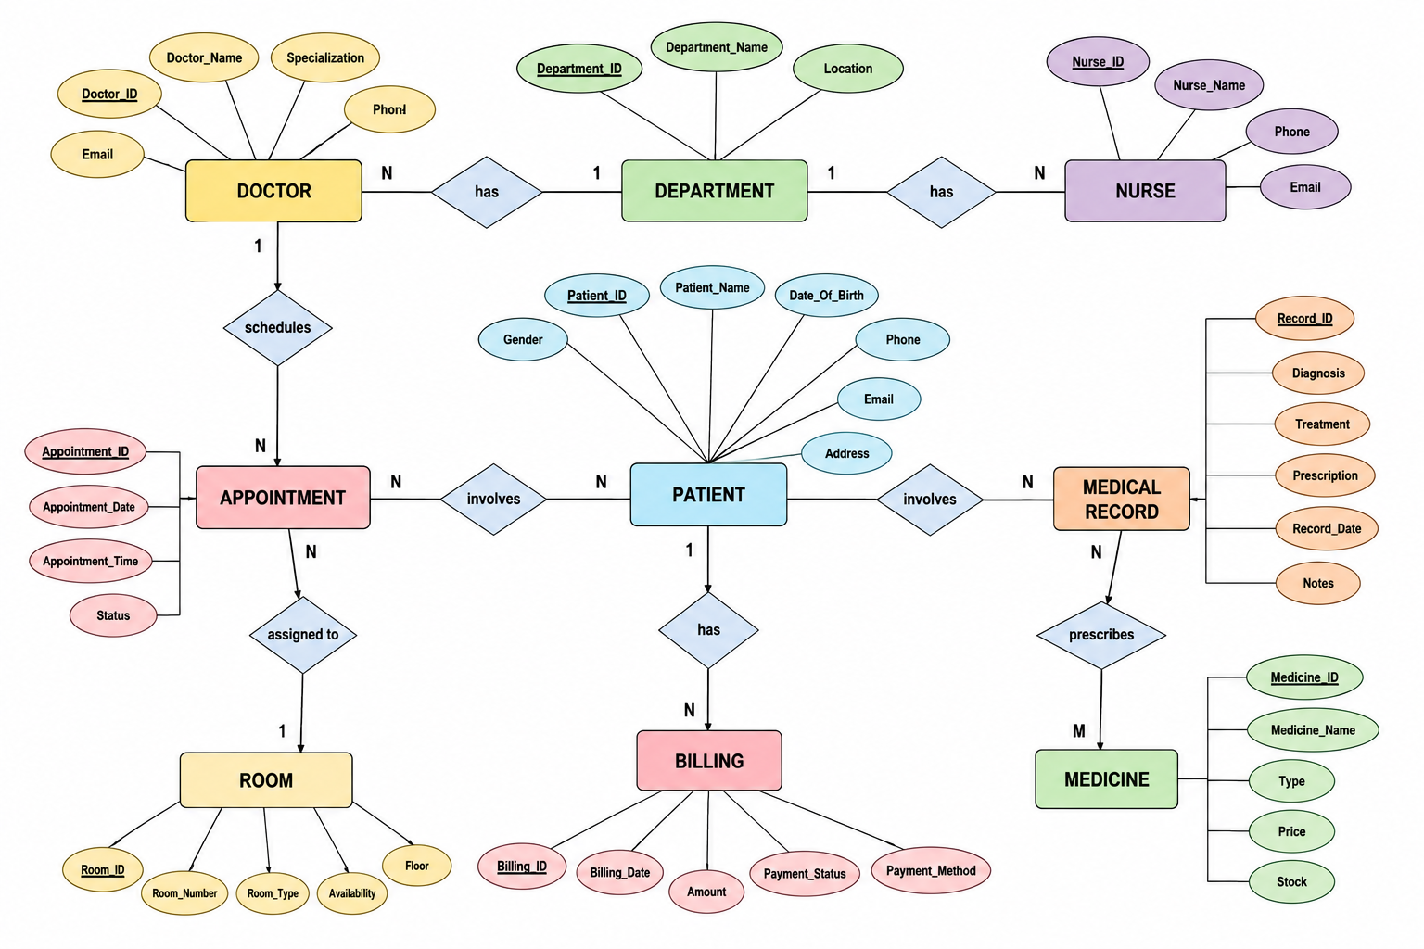

Slide 10
Modules & Functionalities
• Patient Module – Register and manage patient details.
• Doctor Module – Store doctor information and specialization.
• Appointment Module – Schedule and manage appointments.
• Medical Records Module – Maintain patient diagnosis and
treatment details.
• Billing Module – Generate and manage patient bills.
• Medicine Module – Manage medicine details and availability.
• Admin Module – Manage users and overall hospital operations.

Slide 11
SQL Operation & Queries
• CREATE – Creates tables and databases.
• INSERT – Adds new patient, doctor, or appointment records.
• SELECT – Retrieves stored information.
• UPDATE – Modifies existing records.
• DELETE – Removes unwanted records.
• WHERE – Filters specific records.
• ORDER BY – Sorts records.
• GROUP BY – Groups similar data.
• JOIN – Combines data from multiple tables.

Slide 12
Conclusion
the Hospital Management System makes hospital work faster, more organized, and more accurate by reducing manual records and improving coordination. It helps staff manage patients, appointments, billing, and reports efficiently while improving overall service quality

Slide 13
Thank You!

